Slide 1


KEY LOGGER
CH.CHAITHANYA

Slide 2
Keylogger
A keylogger is a type of software or hardware that records the keystrokes on a computer or device. It can capture everything you type, including passwords, messages, and other sensitive information.
Keyloggers are sometimes used for legitimate purposes like monitoring children’s online activities or employee productivity.

Slide 3

agenda
An introduction highlighting the importance of keyloggers, followed by a detailed exploration of project objectives, technical intricacies of key press capture, and the functionality of logging keystrokes to both text and JSON files.
The agenda includes a demonstration of the GUI interface, a discussion on ethical considerations surrounding keyloggers, and a live showcase of the keylogger in operation

Slide 4
PROBLEM STATEMENT
The problem statement is that the keyloggers can be detected using antiviruses. Installation of hardware keyloggers is difficult without the knowledge of the owner of the system. The solution to the above existing problem is that we can build a software keyloggers instead of hardware keyloggers.
Keyloggers are a genuine danger to clients and the client’s information, which is considered exploitative movement.
The problem statement is that the keyloggers can be detected using antiviruses. Installation of hardware keyloggers is difficult without the knowledge of the owner of the system

Slide 5
PROJECT OVERVIEW
In this the key logger code is executed it automatically records the work in the background .
A keylogger, short for keystroke logger, is a type of surveillance technology used to monitor and record each keystroke typed on a keyboard.
keyloggers can be used for various purposes, both legitimate and malicious. They are often employed by employers to ensure employee productivity and security, by parents to monitor their children's online activities, or by malicious actors to steal sensitive information such as passwords and credit card numbers.

Slide 6
Who are the end users
The end users of keyloggers can vary widely depending on the context in which the keylogger is used
Employers and Organizations
Parents and Guardians
IT Administrators and Security Professionals
Law Enforcement Agencie
Researchers and Developers
Educational Institutions
Malicious Actors

Slide 7
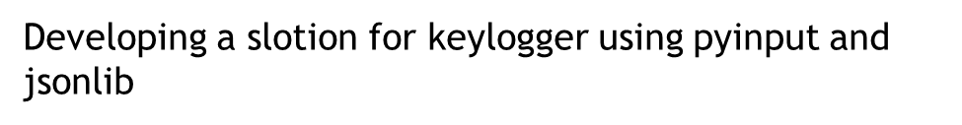
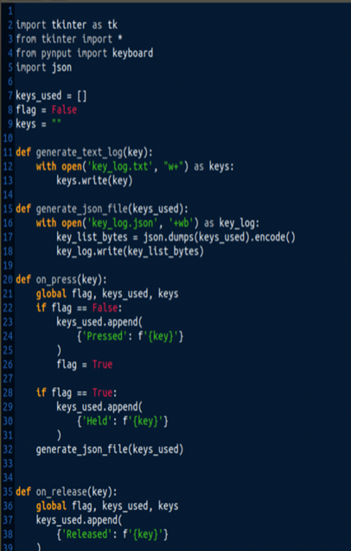
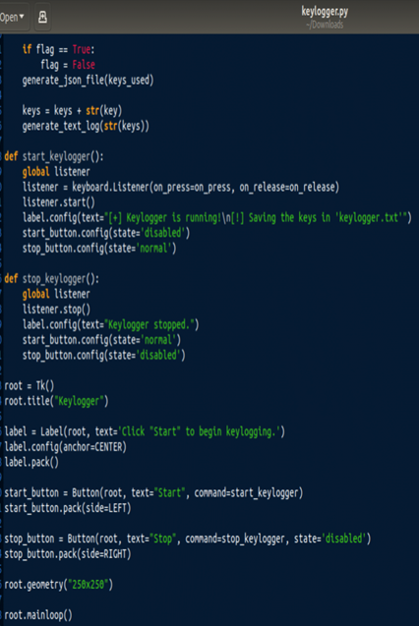

SOLUTION & VALUE PROPOSITION

Slide 8
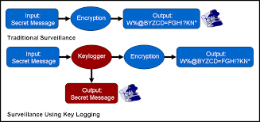
In this we are executing the code in the python org platform
after writing the code before running the code we have to
install the libries in the command prompt with the help of
pip(Preferred Installer Program)
pip install jsonlib
Pip install pynput
Without this libries the
program shows error while
executation

Slide 9
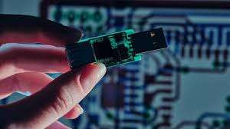
Modeling in the context of developing a keylogger involves creating a detailed plan of its structure, components, interactions, and behaviors. This can include creating diagrams, defining data flows, and outlining the architecture. Here is an approach to modeling a keylogger
Keystroke Capture Module: Captures keystrokes from the keyboard.
Data Storage Module: Stores captured keystrokes securely.
Data Transmission Module: Sends captured data to a remote server or email.
Interface Module: Allows configuration and monitoring of the keylogger

Slide 10
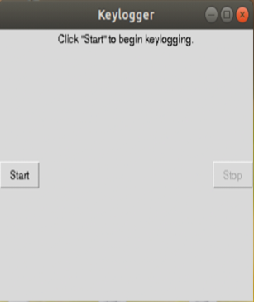
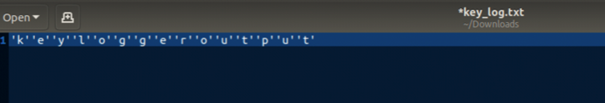
RESULT
As there always two sides of coin just like this keylogger has good as well as bad reputation.
In the world of hacking it is use to hack some ones personal details . While on the other hand it is used in a company to monitor any suspicious activity that may cause serious liability to the company’s benefit.

Slide 11

This Photo by Unknown Author is licensed under CC BY-SA-NC

